Slide 1
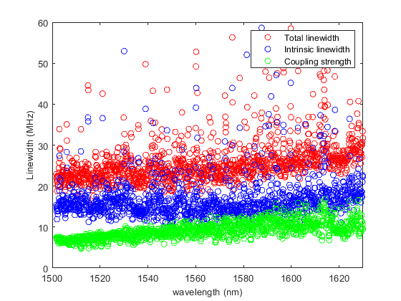
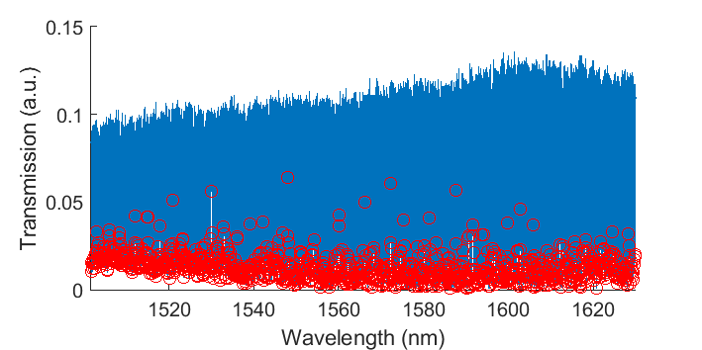
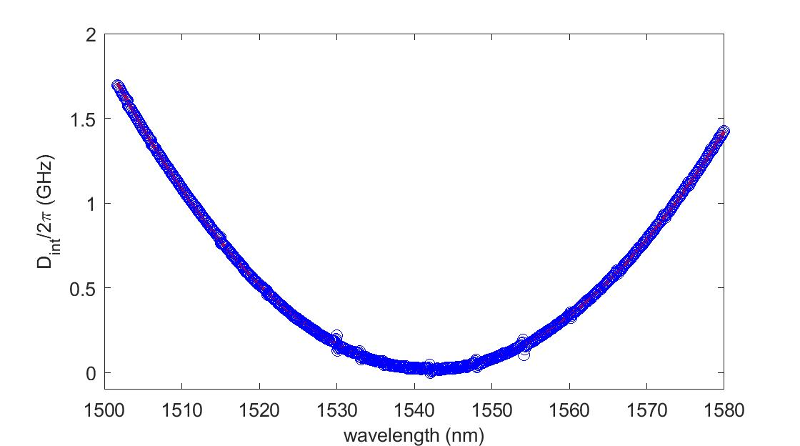
12 GHz Si₃N₄ Microresonator: Characterization
Chip number: D63_1_12GHz_F13_C12
D1 = 12.131 GHz
D2= 19 MHz
In the range around 1542 nm
Total linewidth κ ≈ 22 MHz
Intrinsic linewidth κ₀ ≈ 14 MHz
Intrinsic Q₀ ≈ 14 × 10⁶

Slide 2
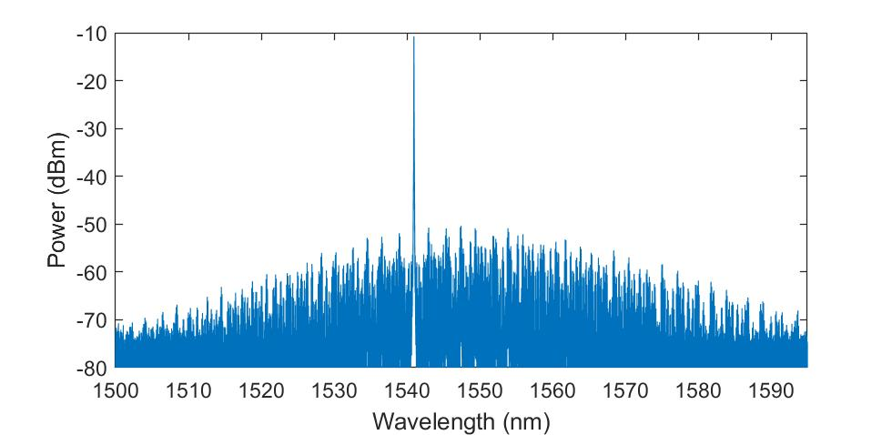
12 GHz Si₃N₄ Microresonator: Multi-soliton generation
Pump wavelength : 1541.5 nm (read from Toptica laser, piezo offset 27.9V)
1541 nm (read from OSA)
Only multi-soliton can be generated, which have around 10 nm shift from pump laser due to Raman effect.
Pump power: 800 mW On chip power: 400 mW

